Slide 1
Operating Systems- Module 2

Slide 2
What is an API?
API, an abbreviation of application program interface, is a set of routines, protocols, and tools for building software applications. A good API makes it easier to develop a program by providing all the building blocks. A programmer then puts the blocks together.
Most operating environments, such as MS-Windows, provide an API so that programmers can write applications consistent with the operating environment. Although APIs are designed for programmers, they are ultimately good for users because they guarantee that all programs using a common API will have similar interfaces. This makes it easier for users to learn new programs.

Slide 3
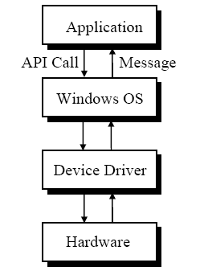
Notes:
3
III IT 2008-2009
CS1233 VP

Slide 4
What is an API?
An API is an abstraction that describes an interface for the interaction with a set of functions used by components of a software system. The software providing the functions described by an API is said to be an implementation of the API.
An API can be:
general, the full set of an API that is bundled in the libraries of a programming language, e.g. Standard Template Library in C++ or Java API.
specific, meant to address a specific problem, e.g. Google Maps API or Java API for XML Web Services.
language-dependent, meaning it is only available by using the syntax and elements of a particular language, which makes the API more convenient to use.
language-independent, written so that it can be called from several programming languages.

Slide 5
WINDOWS API
Purpose
The Microsoft Windows application programming interface (API) provides services used by all Windows-based applications.
You can provide your application with a graphical user interface; access system resources such as memory and devices; display graphics and formatted text; incorporate audio, video, networking, or security.
Where Applicable
The Windows API can be used in all Windows-based applications. The same functions are generally supported on 32-bit and 64-bit Windows.
Developer Audience
This API is designed for use by C/C++ programmers. Familiarity with the Windows graphical user interface and message-driven architecture is required.

Slide 6
EXAMPLE WIN32 API
Application window is created by calling the API function CreateWindow().
Create Window with the comments identifying the parameter.
hwnd = CreateWindow
(“classname”, // window class name
TEXT ("The First Program"), // window caption
WS_OVERLAPPEDWINDOW, // window style
CW_USEDEFAULT, // initial x position
CW_USEDEFAULT, // initial y position
CW_USEDEFAULT, // initial x size
CW_USEDEFAULT, // initial y size
NULL, // parent window handle
NULL, // window menu handle
hInstance, // program instance handle
NULL) ; // creation parameters, may be used to point some data for reference.
Overlapped window will be created, it includes a title bar, system menu to the left of title bar, a thick window sizing border, minimize, maximize and close button to the right of the title bar.
The window will be placed in default x, y position with default size. It is a top level window without any menu.
The CreateWindow() will returns a handle which is stored in hwnd.
Notes:
6
III IT 2008-2009
CS1233 VP

Slide 7
Characteristics of a Good API
Easy to learn
Easy to use, even without documentation
Hard to misuse
Easy to read and maintain code that uses it
Sufficiently powerful to satisfy requirements
Easy to evolve
Appropriate to audience
Notes:
If you get it right, it looks obvious in retrospect. It’s a good sign if people say: “of course that’s how it should look; so what?”
Appropriate to audience: a good API in C++ might be a bad API in Java; a good API for economists might be a bad API for physicists.

Slide 8
System Calls
Programming interface to the services provided by the OS
The kernel is a computer program that is the core of a computer’s operating system, with complete control over everything in the system.
A system call is how a program requests a service from an operating system's kernel.
System calls provide an essential interface between a process and the operating system.
Typically written in a high-level language (C or C++) can be written in assembly language for low level tasks.
Mostly accessed by programs via a high-level Application Program Interface (API) rather than direct system call use
Three most common APIs are Win32 API for Windows, POSIX API for POSIX-based systems (including virtually all versions of UNIX, Linux, and Mac OS X), and Java API for the Java virtual machine (JVM)

Slide 9
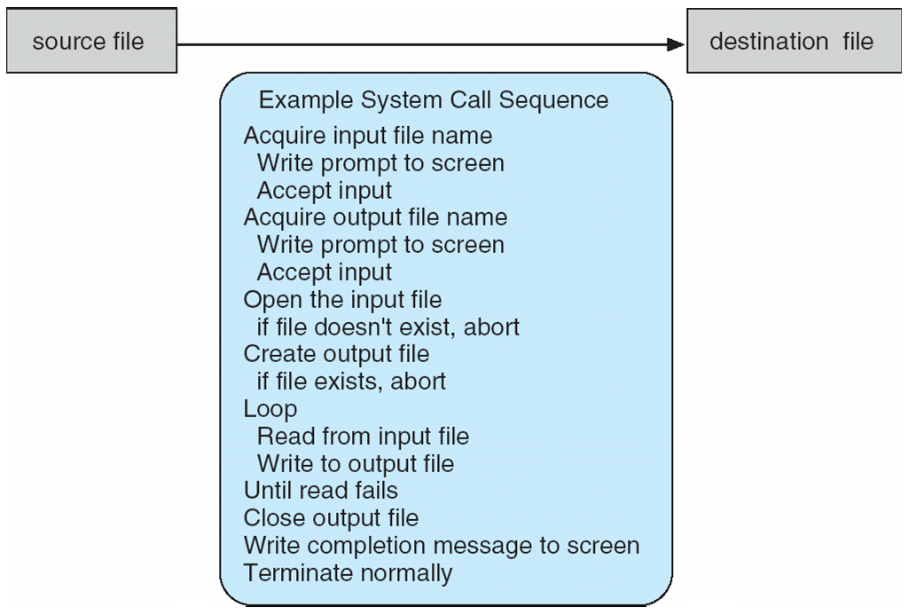
Example of System Calls
System call sequence to copy the contents of one file to another file

Slide 10
System Call Implementation
Typically, a number associated with each system call
System-call interface maintains a table indexed according to these numbers
The system call interface invokes intended system call in OS kernel and returns status of the system call and any return values
The caller need know nothing about how the system call is implemented
Just needs to obey API and understand what OS will do as a result call
Most details of OS interface hidden from programmer by API
Managed by run-time support library (set of functions built into libraries

Slide 11
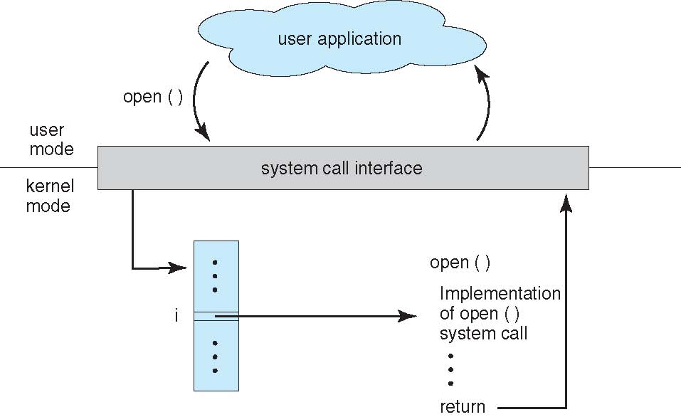
API – System Call – OS Relationship

Slide 12
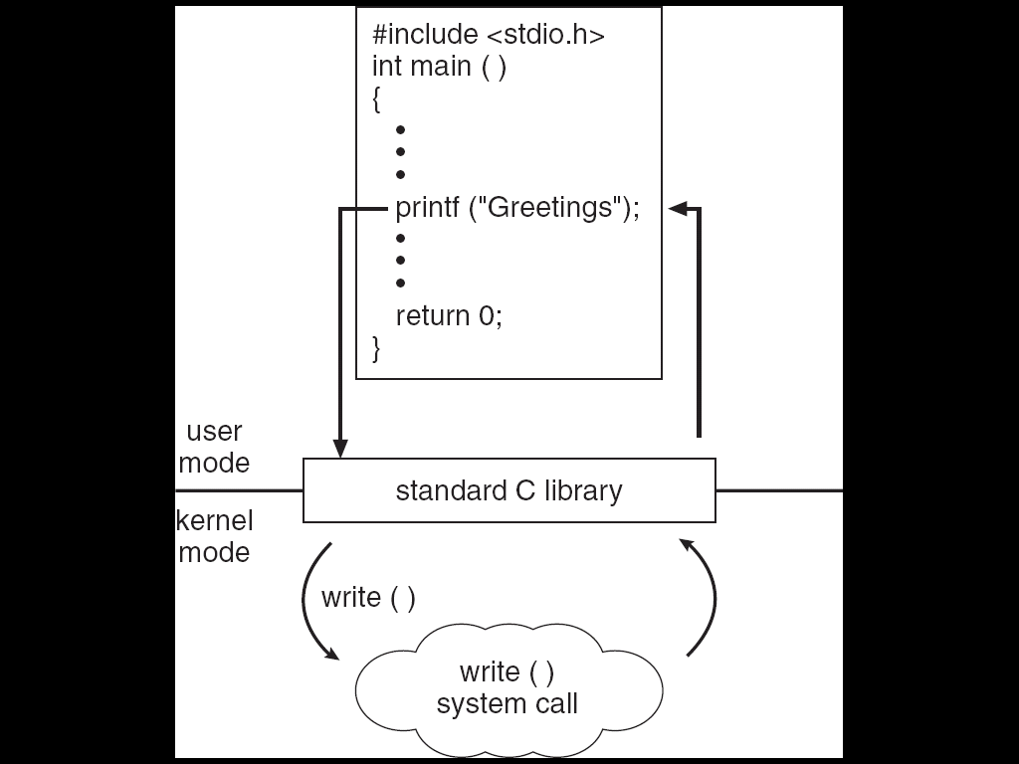
Standard C Library Example
C program invoking printf() library call, which calls write() system call

Slide 13
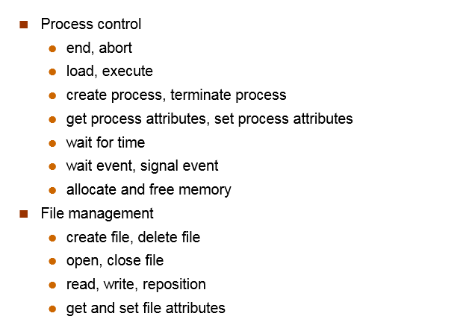
System calls

Slide 14
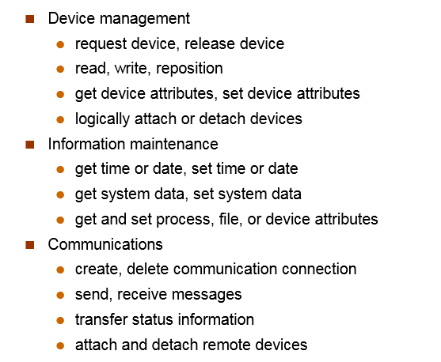

Slide 15
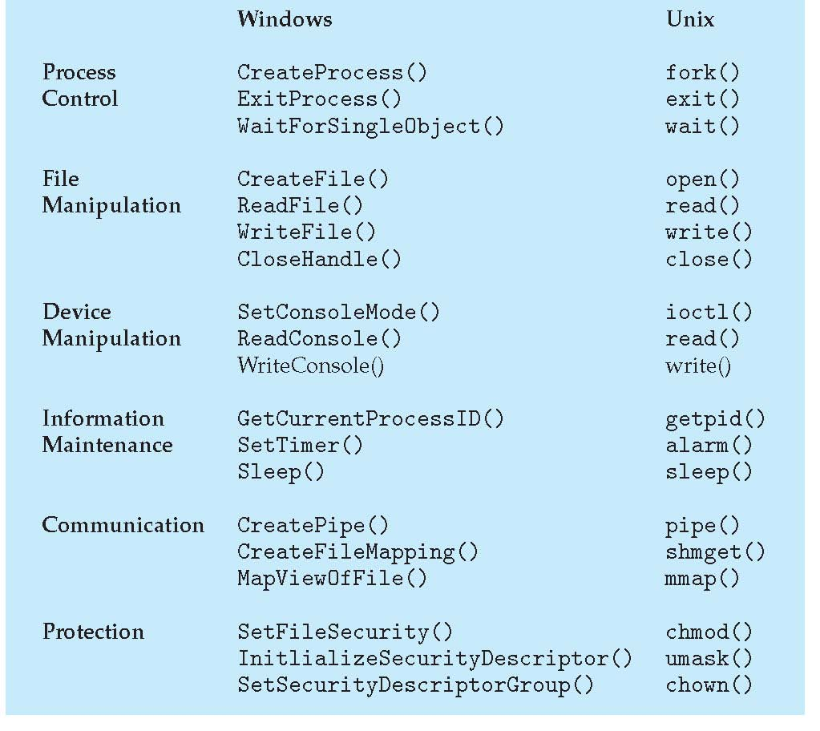
Examples of Windows and Unix System Calls

Slide 16
Process Concept
An operating system executes a variety of programs:
Batch system – jobs
Time-shared systems – user programs or tasks
Textbook uses the terms job and process almost interchangeably
Process – a program in execution;
The entity that can be assigned to and executed on a processor
Multiple parts
The program code, also called text section
Current activity including program counter, processor registers
Stack containing temporary data
Function parameters, return addresses, local variables
Data section containing global variables
Heap containing memory dynamically allocated during run time

Slide 17
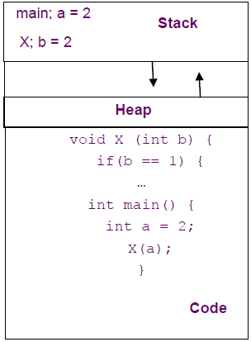
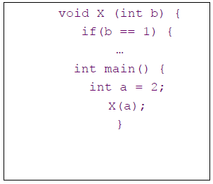
Program to Process
We write a program in e.g., C.
A compiler turns that program into an instruction list.
The CPU interprets the instruction list (which is more a graph of basic blocks).
What is in memory.
What you wrote

Slide 18
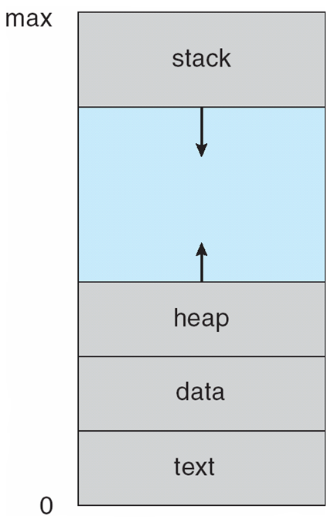
Process in Memory

Slide 19
Process Concept (Cont.)
Program is passive entity stored on disk , process is active
Program becomes process when file loaded into memory
Execution of program started via GUI mouse clicks, command line entry of its name, etc

Slide 20
Program, executable and process
In order to execute a program, the operating system must first create a process and make the process execute the program.
Program
A set of instructions which is in human readable format. A passive entity stored on secondary storage.
Executable
A compiled form of a program including machine instructions and static data that a computer can load and execute. A passive entity stored on secondary storage.
Process
A program loaded into memory and executing or waiting. A process typically executes for only a short time before it either finishes or needs to perform I/O (waiting). A process is an active entity and needs resources such as CPU time, memory etc to execute.

Slide 21
Process State
As a process executes, it changes state
new: The process is being created
running: Instructions are being executed
waiting: The process is waiting for some event to occur
ready: The process is waiting to be assigned to a processor
terminated: The process has finished execution

Slide 22
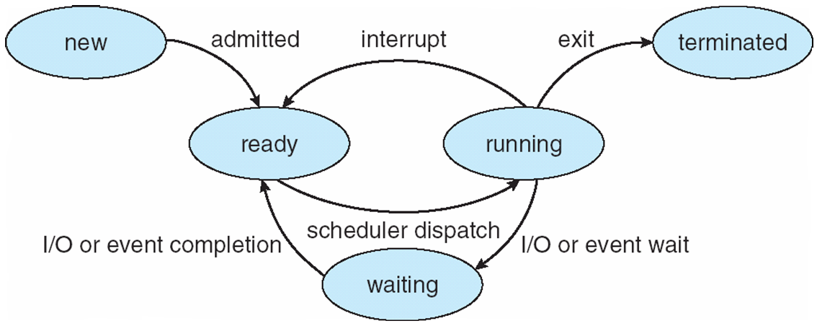
Diagram of Process State

Slide 23
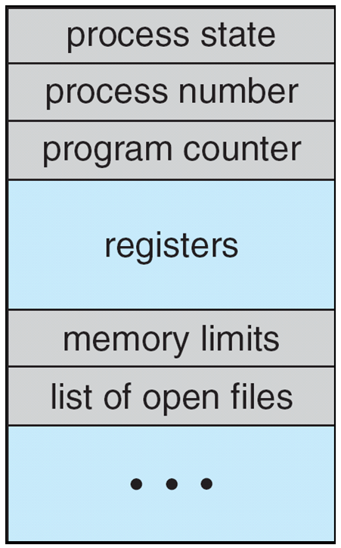
Process Control Block (PCB)
Information associated with each process
(also called task control block)
Process state – running, waiting, etc
Program counter – location of instruction to next execute
CPU registers – contents of all process-centric registers
CPU scheduling information- priorities, scheduling queue pointers
Memory-management information – memory allocated to the process
Accounting information – CPU used, clock time elapsed since start, time limits
I/O status information – I/O devices allocated to process, list of open files

Slide 24
Process Scheduling
Maximize CPU use, quickly switch processes onto CPU for time sharing
Process scheduler selects among available processes for next execution on CPU
Maintains scheduling queues of processes
Job queue – set of all processes in the system
Ready queue – set of all processes residing in main memory, ready and waiting to execute
Device queues – set of processes waiting for an I/O device
Processes migrate among the various queues

Slide 25
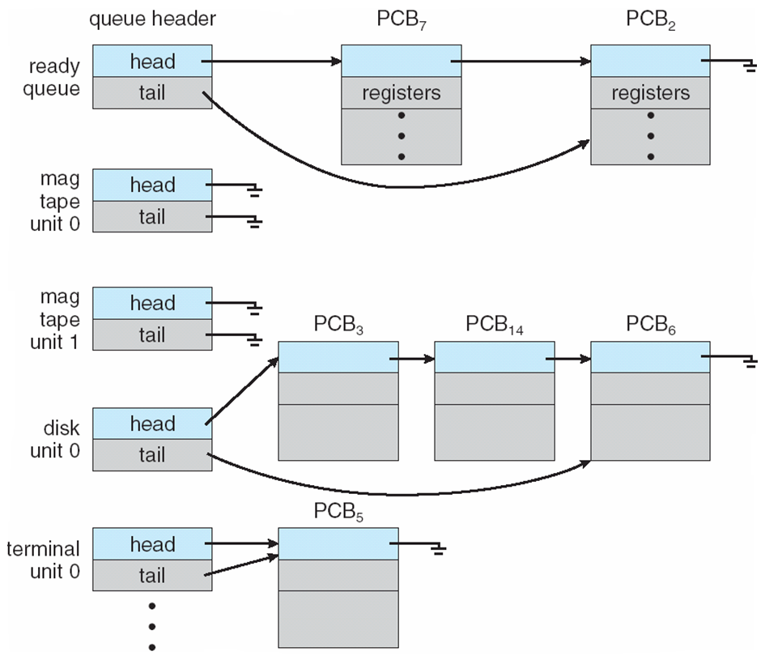
Ready Queue And Various I/O Device Queues

Slide 26
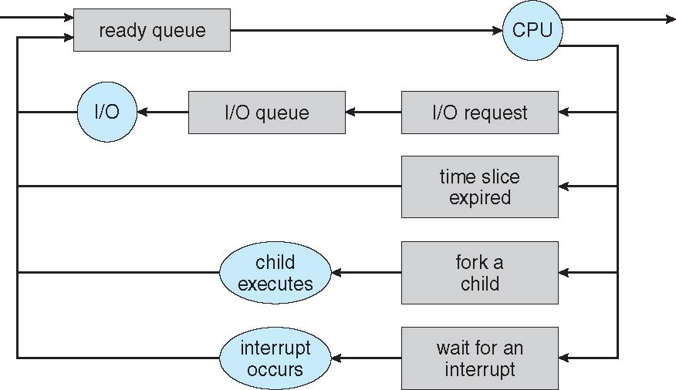
Representation of Process Scheduling
Queueing diagram represents queues, resources, flows

Slide 27
Schedulers
Short-term scheduler (or CPU scheduler) – selects which process should be executed next and allocates CPU
Sometimes the only scheduler in a system
Short-term scheduler is invoked frequently (milliseconds) ⇒ (must be fast)
Long-term scheduler (or job scheduler) – selects which processes should be brought into the ready queue
Long-term scheduler is invoked infrequently (seconds, minutes) ⇒ (may be slow)
The long-term scheduler controls the degree of multiprogramming
Processes can be described as either:
I/O-bound process – spends more time doing I/O than computations, many short CPU bursts
CPU-bound process – spends more time doing computations; few very long CPU bursts
Long-term scheduler strives for good process mix

Slide 28
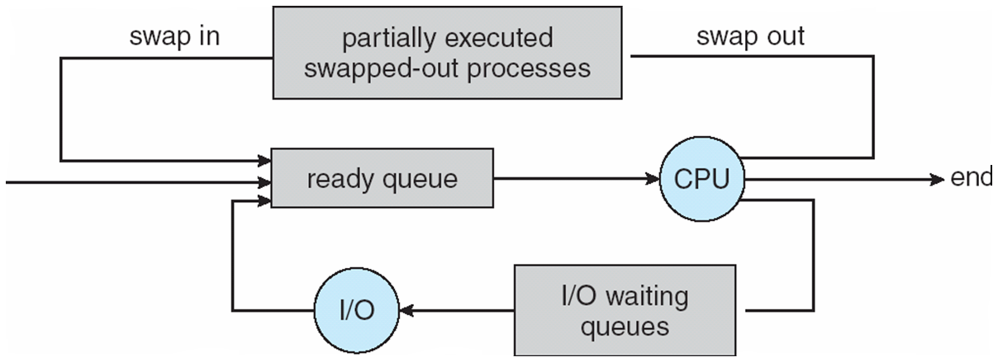
Addition of Medium Term Scheduling
Medium-term scheduler can be added if degree of multiple programming needs to decrease
Remove process from memory, store on disk, bring back in from disk to continue execution: swapping

Slide 29
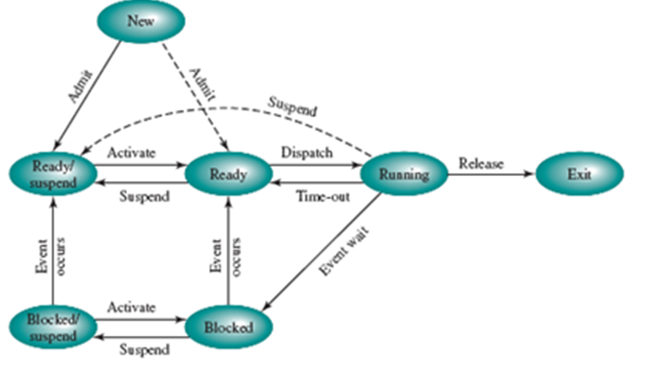

Slide 30
Context Switch
When CPU switches to another process, the system must save the state of the old process and load the saved state for the new process via a context switch
Context of a process represented in the PCB
Context-switch time is overhead; the system does no useful work while switching
The more complex the OS and the PCB ➔ the longer the context switch
Time dependent on hardware support

Slide 31
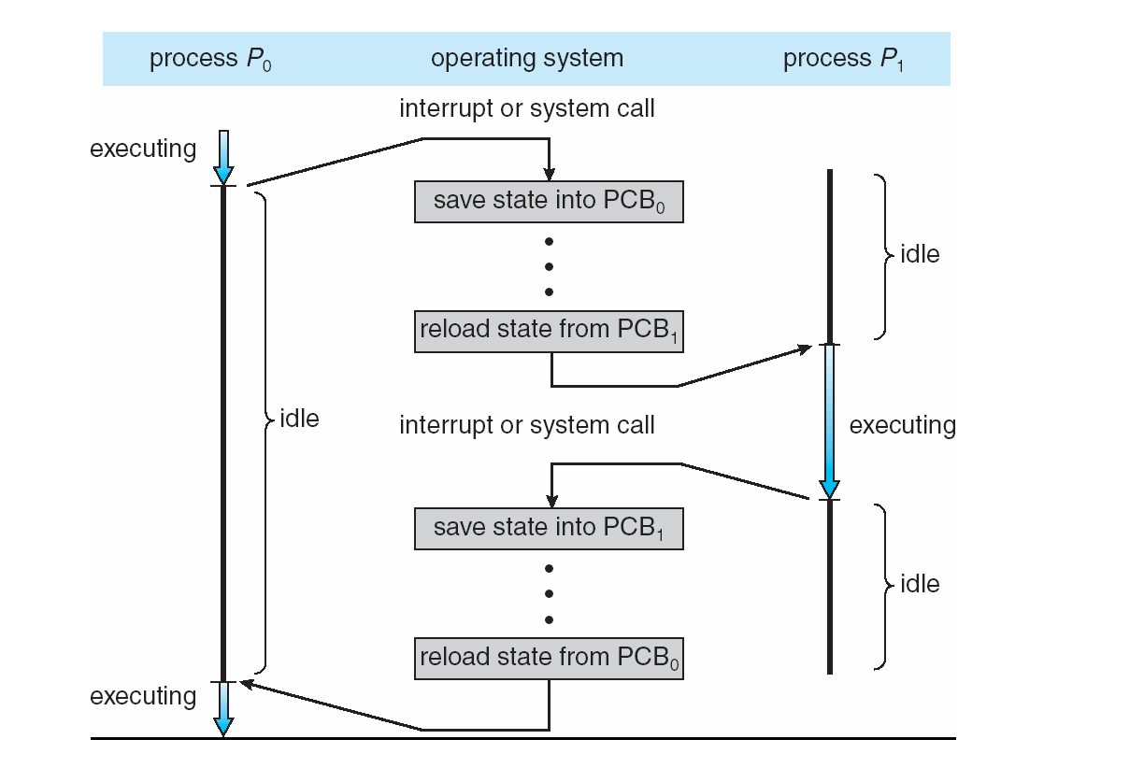
CPU Switch From Process to Process

Slide 32
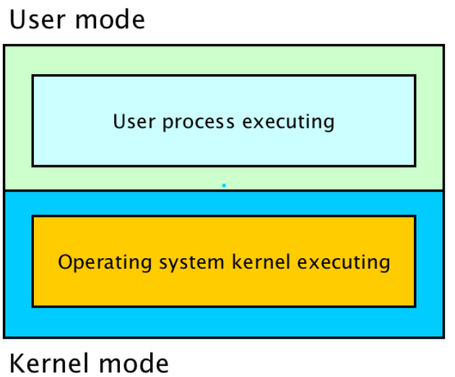
Operating system operations

Slide 33
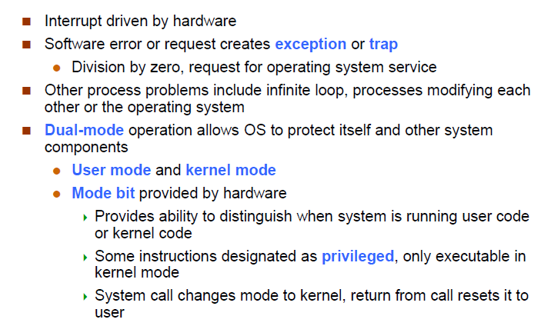
Operating system operations

Slide 34
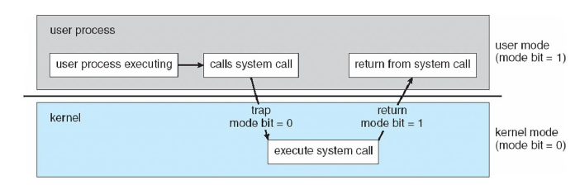
Transition from user to kernel mode

Slide 35
Exception and interrupts
Exceptions are internal and synchronous
Exceptions are used to handle internal program errors.
Overflow, division by zero and bad data address are examples of internal errors in a program.
Another name for exception is trap. A trap (or exception) is a software generated interrupt.
Exceptions are produced by the CPU control unit while executing instructions and are considered to be synchronous because the control unit issues them only after terminating the execution of an instruction.
Interrupts are external and asynchronous
Interrupts are used to notify the CPU of external events.
Interrupts are generated by hardware devices outside the CPU at arbitrary times with respect to the CPU clock signals and are therefore considered to be asynchronous.
Read and write requests to disk is similar to key presses.

Slide 36
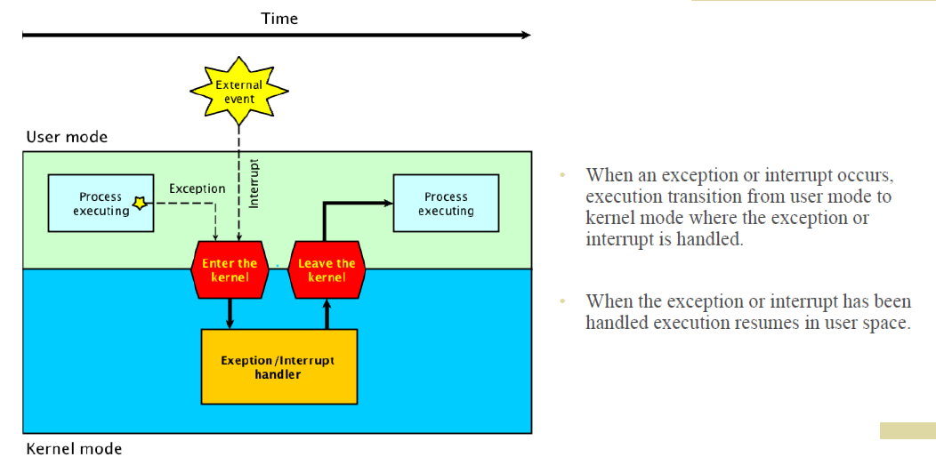
Exception and interrupt handler

Slide 37
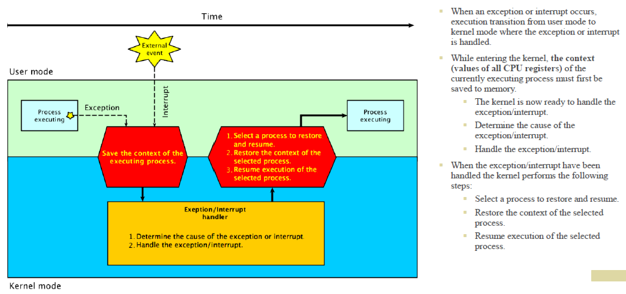

Slide 38
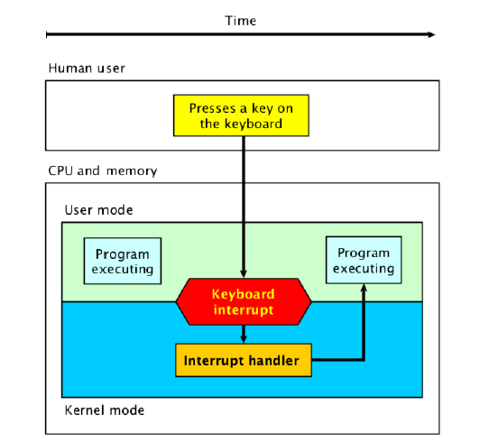
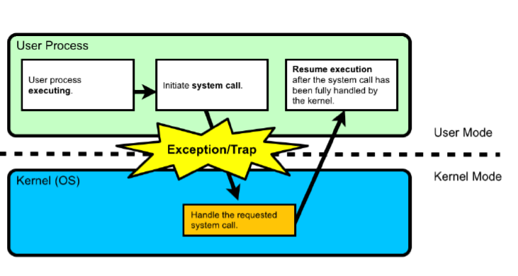

Slide 39
Operations on Processes
System must provide mechanisms for:
process creation,
process termination

Slide 40
Process Creation
Parent process create children processes, which, in turn create other processes, forming a tree of processes
Generally, process identified and managed via a process identifier (pid)
Resource sharing options
Parent and children share all resources
Children share subset of parent’s resources
Parent and child share no resources
Execution options
Parent and children execute concurrently
Parent waits until children terminate

Slide 41
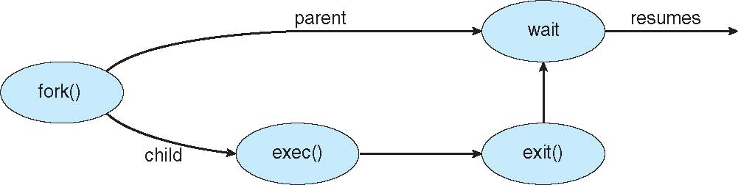
Process Creation (Cont.)
Address space
Child duplicate of parent
Child has a program loaded into it
UNIX examples
fork() system call creates new process
exec() system call used after a fork() to replace the process’ memory space with a new program

Slide 42
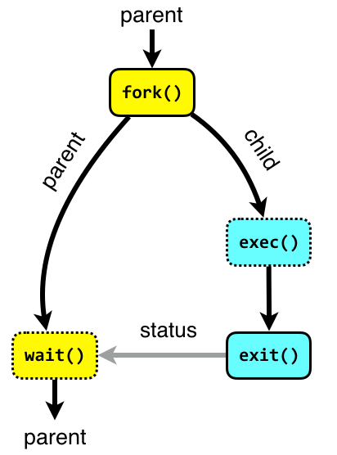
Process Management - System calls
The following system calls are used for basic process management.
fork
A parent process uses fork to create a new child process. The child process is a copy of the parent. After fork, both parent and child executes the same program but in separate processes.
exec
Replaces the program executed by a process. The child may use exec after a fork to replace the process’ memory space with a new program executable making the child execute a different program than the parent.
exit
Terminates the process with an exit status.
wait
The parent may use wait to suspend execution until a child terminates. Using wait the parent can obtain the exit status of a terminated child

Slide 43
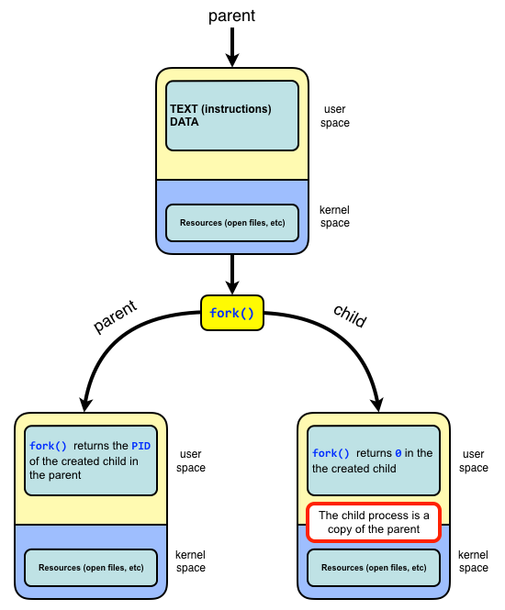
Process Mgt. - System Calls
#include <unistd.h>
pid_t fork(void);
On success, the PID of the child process is returned in the parent, and 0 is returned in the child.
On failure, -1 is returned in the parent, no child process is created, and errno is set appropriately.
Fork returns twice on success
On success fork returns twice: once in the parent and once in the child.
After calling fork, the program can use the fork return value to tell whether executing in the parent or child.
If the return value is 0 the program executes in the new child process.
If the return value is greater than zero, the program executes in the parent process and the return value is the process ID (PID) of the created child process.
On failure fork returns -1.

Slide 44
fork() - example
int main(void) {
pid_t pid;
switch (pid = fork()) {
case -1:
// On error fork() returns -1.
perror("fork failed");
exit(EXIT_FAILURE);
case 0:
// On success fork() returns 0 in the child.
child();
default:
// On success fork() returns the pid of the child to the parent.
parent(pid);
}
}
void child()
{
printf(" CHILD <%ld> I'm alive! My PID is <%ld> and my parent got PID <%ld>.\n", (long) getpid(), (long) getpid(), (long) getppid());
printf(" CHILD <%ld> Goodbye!\n", (long) getpid()); exit(EXIT_SUCCESS);
}
void parent(pid_t pid)
{
printf("PARENT <%ld> My PID is <%ld> and I spawned a child with PID <%ld>.\n", (long) getpid(), (long) getpid(), (long) pid); printf("PARENT <%ld> Goodbye!\n", (long) getpid()); exit(EXIT_SUCCESS);
}

Slide 45
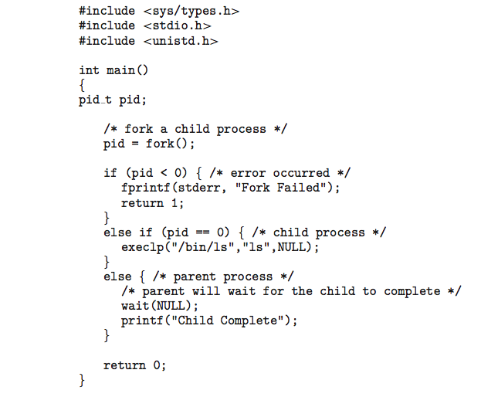
C Program Forking Separate Process

Slide 46
Process Termination
Process executes last statement and then asks the operating system to delete it using the exit() system call.
Returns status data from child to parent (via wait())
Process’ resources are deallocated by operating system
Parent may terminate the execution of children processes using the abort() system call. Some reasons for doing so:
Child has exceeded allocated resources
Task assigned to child is no longer required
The parent is exiting and the operating systems does not allow a child to continue if its parent terminates

Slide 47
Process Termination
Some operating systems do not allow child to exist if its parent has terminated. If a process terminates, then all its children must also be terminated.
cascading termination. All children, grandchildren, etc. are terminated.
The termination is initiated by the operating system.
The parent process may wait for termination of a child process by using the wait()system call. The call returns status information and the pid of the terminated process
pid = wait(&status);
If no parent waiting (did not invoke wait()) process is a zombie
If parent terminated without invoking wait , process is an orphan

Slide 48
Orphans
An orphan process is a process whose parent process has terminated, though it remains running itself.
Any orphaned process will be immediately adopted by the special init system process with PID 1.
Processes execute concurrently
Both the parent process and the child process competes for the CPU with all other processes in the system.
The operating systems decides which process to execute when and for how long. The process in the system execute concurrently.
In our example program:
most often the parent terminates before the child and the child becomes an orphan process adopted by init (PID = 1) and therefore reports PPID = 1
sometimes the child process terminates before its parent and then the child is able to report PPID equal to the PID of the parent.

Slide 49
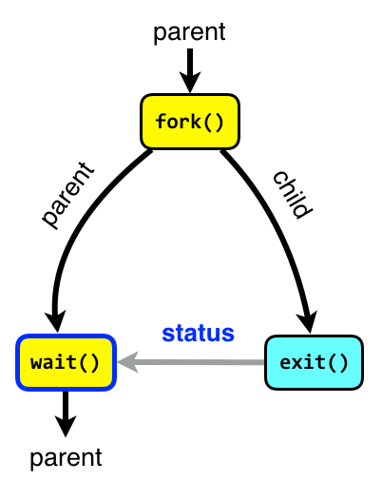
Wait
The wait system call blocks the caller until one of its child process terminates.
If the caller doesn’t have any child processes, wait returns immediately without blocking the caller.
Using wait the parent can obtain the exit status of the terminated child.
#include <sys/types.h>
#include <sys/wait.h>
pid_t wait(int *status);
On success, wait returns the PID of the terminated child.
On failure (no child), wait returns -1.

Slide 50
Zombies
A terminated process is said to be a zombie or defunct until the parent does wait on the child.
When a process terminates all of the memory and resources associated with it are deallocated so they can be used by other processes.
However, the exit status is maintained in the PCB until the parent picks up the exit status using wait and deletes the PCB.
A child process always first becomes a zombie.
In most cases, under normal system operation zombies are immediately waited on by their parent.
Processes that stay zombies for a long time are generally an error and cause a resource leak.

Slide 51
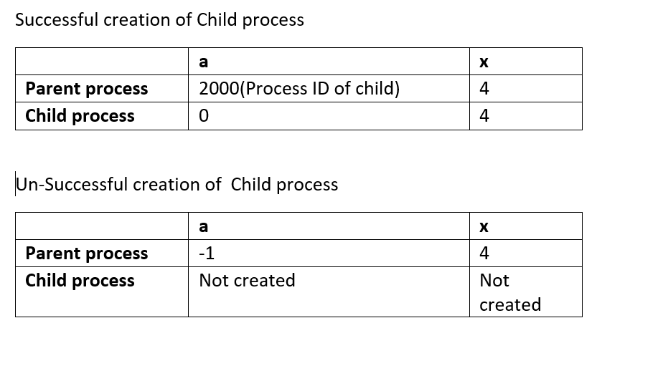

Slide 52
